Slide 1
Weekly Report
Wangwon Lee, 2019/04/27
This week | Next week
Visualization Apply AM method to 1D-model Process detail In output layer Analyze like SampleCNN paper | Visualization Compare AM result with filter Find another method for listening Study Brain data AFNI
Interesting and new finding
Visualization Activation Maximization
The aim of this month / Discussion
The aim of this month: To investigate about CNN and visualization.
Notes:
I want you to follow this rule

Slide 2
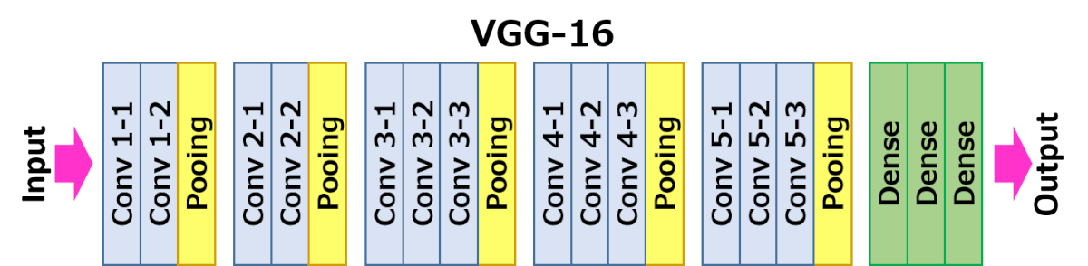
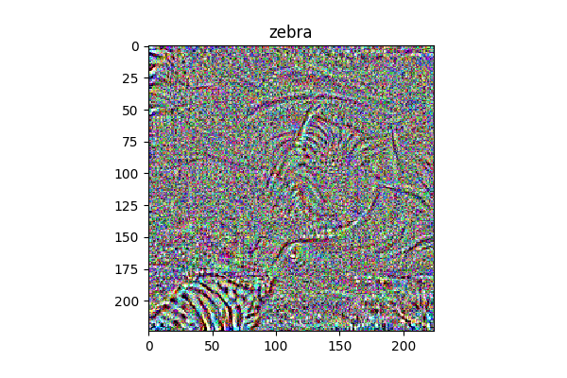
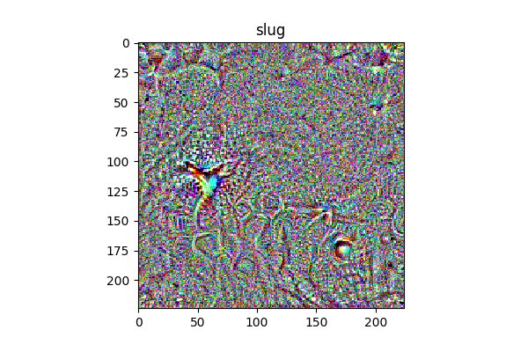
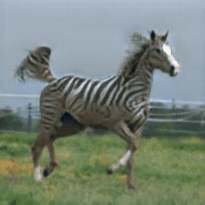
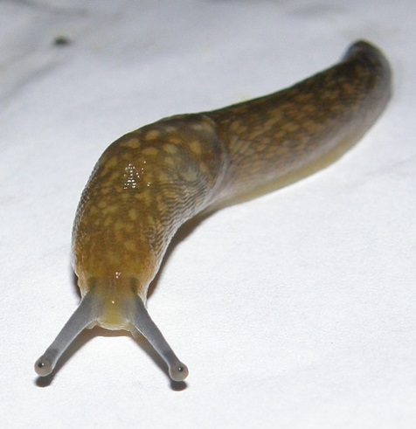
Visualization - Previous Work
In Softmax layer, if target node’s activation is higher, that is representation of target label
- 2 -
Notes:
Supporting facts

Slide 3
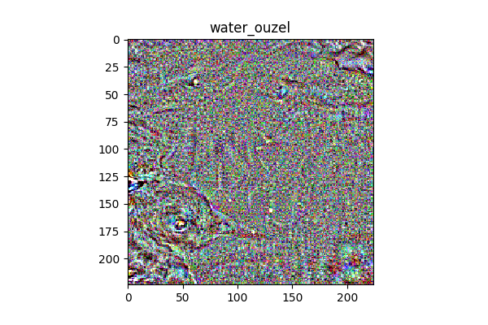
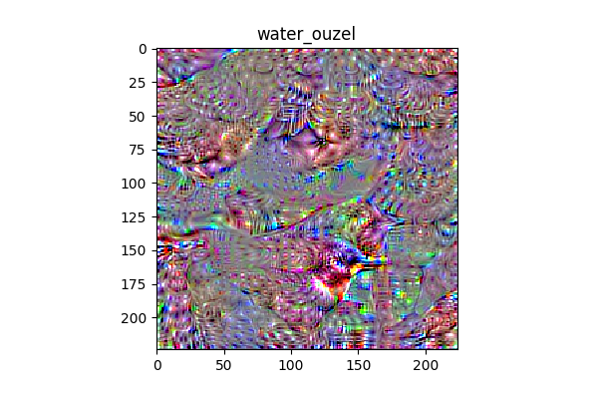
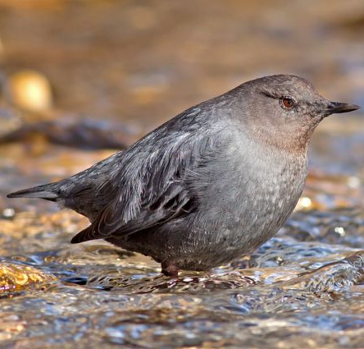
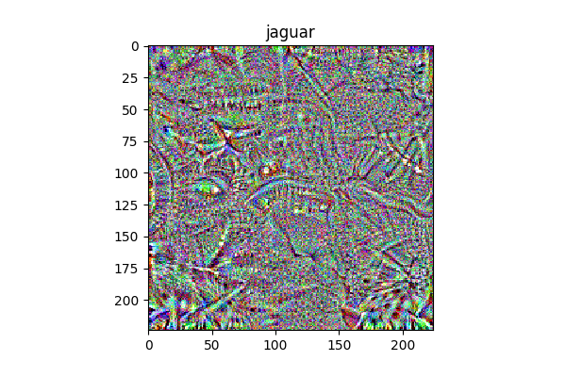
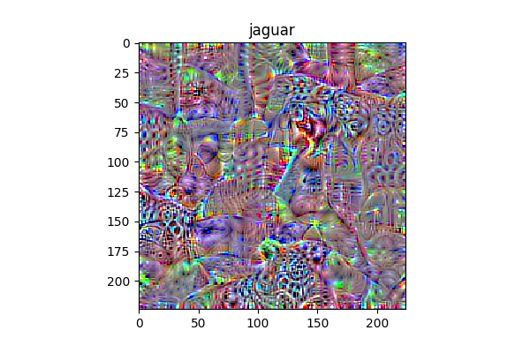

Visualization - Previous Work
- 3 -
Notes:
Supporting facts

Slide 4
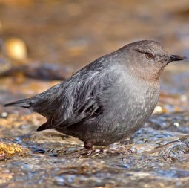
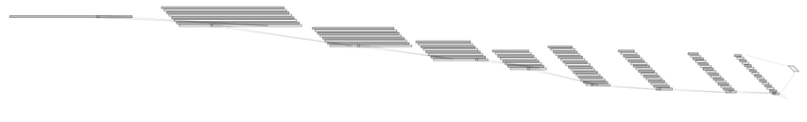
AM in 1D Model
EX)
EX)
1@16000
32@16000
?
32@5333
32@1777
Conv(5)
Conv(5)
MaxPool(3)
32@592
64@197
64@65
64@21
64@7
Conv(5)
MaxPool(3)
Conv(5)
MaxPool(3)
Conv(5)
MaxPool(3)
Conv(5)
MaxPool(3)
Conv(5)
MaxPool(3)
Conv(5)
MaxPool(3)
- 4 -
Notes:
Supporting facts

Slide 5
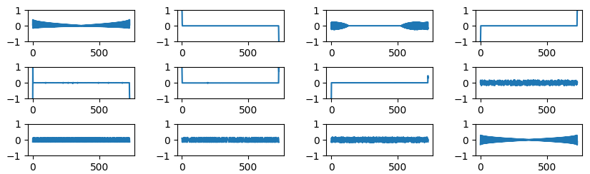
AM in 1D Model – 1st layer
1@16000
32@16000
32@5333
Conv(5)
32@1777
32@592
64@197
64@65
64@21
Conv(5)
MaxPool(3)
64@7
Conv(5)
MaxPool(3)
Conv(5)
MaxPool(3)
Conv(5)
MaxPool(3)
Conv(5)
MaxPool(3)
Conv(5)
MaxPool(3)
Conv(5)
MaxPool(3)
[ 1D model 1st layer ]
As the layer becomes deeper, the shape of the waveform becomes more clear.
- 5 -
Notes:
Supporting facts

Slide 6
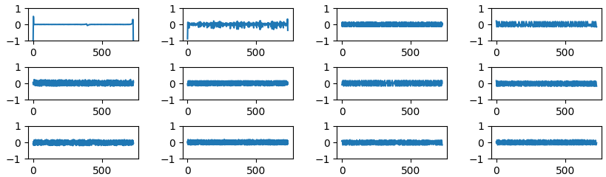
AM in 1D Model – 2nd layer
1@16000
32@16000
32@5333
Conv(5)
32@1777
32@592
64@197
64@65
64@21
Conv(5)
MaxPool(3)
64@7
Conv(5)
MaxPool(3)
Conv(5)
MaxPool(3)
Conv(5)
MaxPool(3)
Conv(5)
MaxPool(3)
Conv(5)
MaxPool(3)
Conv(5)
MaxPool(3)
[ 1D model 2nd layer ]
As the layer becomes deeper, the shape of the waveform becomes more clear.
- 6 -
Notes:
Supporting facts

Slide 7
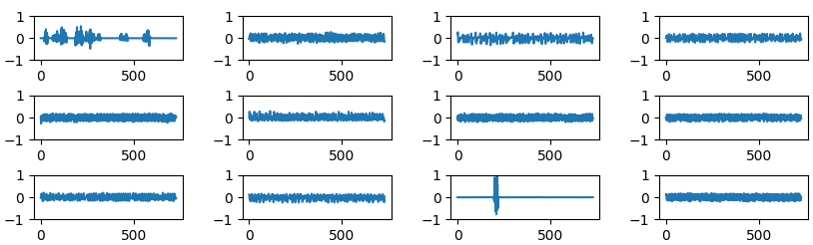
AM in 1D Model – 3rd layer
1@16000
32@16000
32@5333
Conv(5)
32@1777
32@592
64@197
64@65
64@21
Conv(5)
MaxPool(3)
64@7
Conv(5)
MaxPool(3)
Conv(5)
MaxPool(3)
Conv(5)
MaxPool(3)
Conv(5)
MaxPool(3)
Conv(5)
MaxPool(3)
Conv(5)
MaxPool(3)
[ 1D model 3rd layer ]
As the layer becomes deeper, the shape of the waveform becomes more clear.
- 7 -
Notes:
Supporting facts

Slide 8
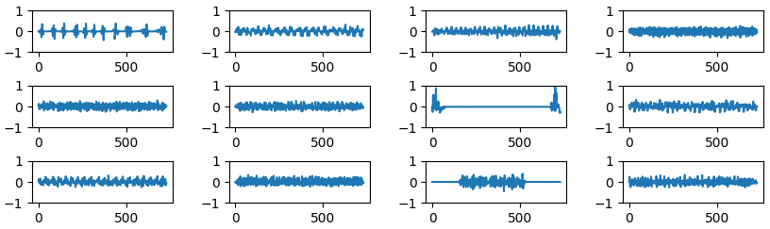
AM in 1D Model – 4th layer
1@16000
32@16000
32@5333
Conv(5)
32@1777
32@592
64@197
64@65
64@21
Conv(5)
MaxPool(3)
64@7
Conv(5)
MaxPool(3)
Conv(5)
MaxPool(3)
Conv(5)
MaxPool(3)
Conv(5)
MaxPool(3)
Conv(5)
MaxPool(3)
Conv(5)
MaxPool(3)
[ 1D model 4th layer ]
As the layer becomes deeper, the shape of the waveform becomes more clear.
- 8 -
Notes:
Supporting facts

Slide 9
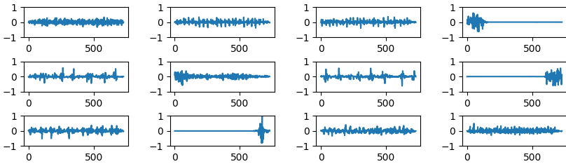
AM in 1D Model – 5th layer
1@16000
32@16000
32@5333
Conv(5)
32@1777
32@592
64@197
64@65
64@21
Conv(5)
MaxPool(3)
64@7
Conv(5)
MaxPool(3)
Conv(5)
MaxPool(3)
Conv(5)
MaxPool(3)
Conv(5)
MaxPool(3)
Conv(5)
MaxPool(3)
Conv(5)
MaxPool(3)
[ 1D model 5th layer ]
As the layer becomes deeper, the shape of the waveform becomes more clear.
- 9 -
Notes:
Supporting facts

Slide 10
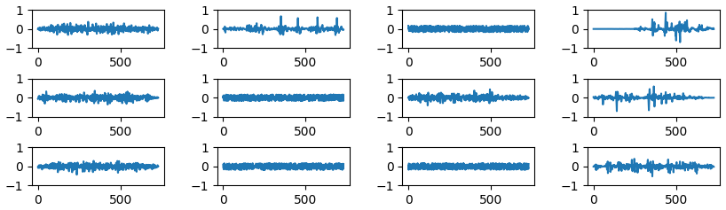
AM in 1D Model – 6th layer
1@16000
32@16000
32@5333
Conv(5)
32@1777
32@592
64@197
64@65
64@21
Conv(5)
MaxPool(3)
64@7
Conv(5)
MaxPool(3)
Conv(5)
MaxPool(3)
Conv(5)
MaxPool(3)
Conv(5)
MaxPool(3)
Conv(5)
MaxPool(3)
Conv(5)
MaxPool(3)
[ 1D model 6th layer ]
As the layer becomes deeper, the shape of the waveform becomes more clear.
- 10 -
Notes:
Supporting facts

Slide 11
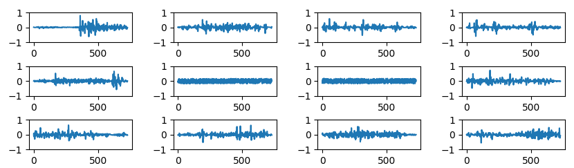
AM in 1D Model – 7th layer
1@16000
32@16000
32@5333
Conv(5)
32@1777
32@592
64@197
64@65
64@21
Conv(5)
MaxPool(3)
64@7
Conv(5)
MaxPool(3)
Conv(5)
MaxPool(3)
Conv(5)
MaxPool(3)
Conv(5)
MaxPool(3)
Conv(5)
MaxPool(3)
Conv(5)
MaxPool(3)
[ 1D model 7th layer ]
As the layer becomes deeper, the shape of the waveform becomes more clear.
- 11 -
Notes:
Supporting facts

Slide 12
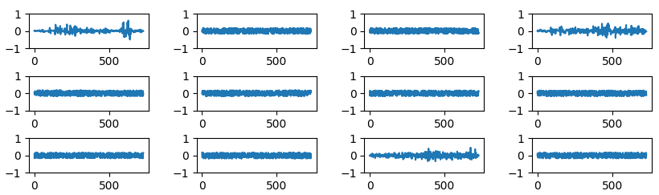
AM in 1D Model – 8th layer
1@16000
32@16000
32@5333
Conv(5)
32@1777
32@592
64@197
64@65
64@21
Conv(5)
MaxPool(3)
64@7
Conv(5)
MaxPool(3)
Conv(5)
MaxPool(3)
Conv(5)
MaxPool(3)
Conv(5)
MaxPool(3)
Conv(5)
MaxPool(3)
Conv(5)
MaxPool(3)
[ 1D model 8th layer ]
A lot of waveform becomes flat again.
Although each shape is similar, but the frequencies of each waveform are different.
- 12 -
Notes:
Supporting facts

Slide 13
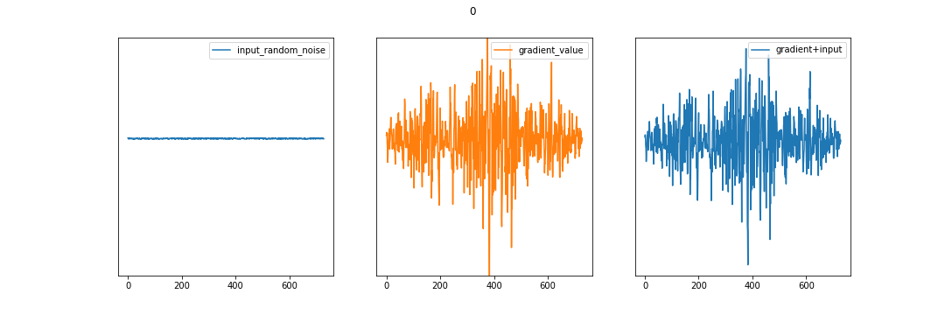
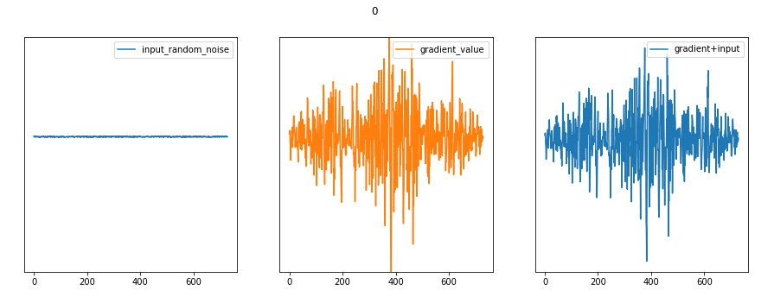
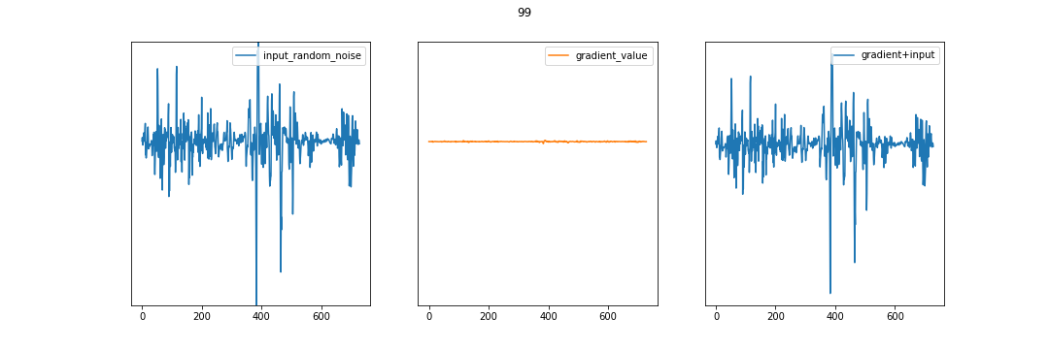
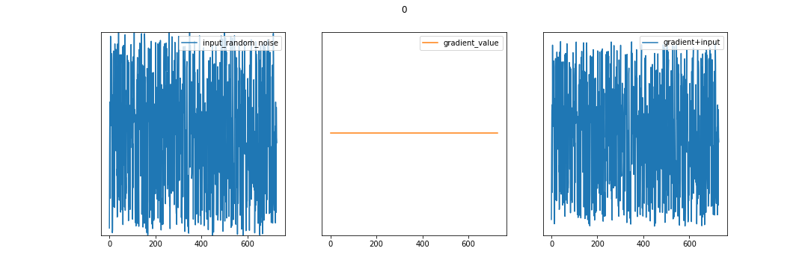
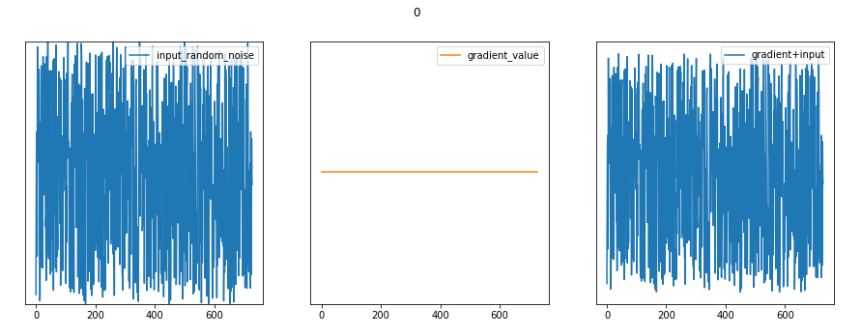

AM in 1D Model - detail
Generate process of waveform
Depending on the generated noise, the update may not be performed.
Start
Each iteration
End
1st
Filter
2nd
Filter
- 13 -
Notes:
Supporting facts

Slide 14
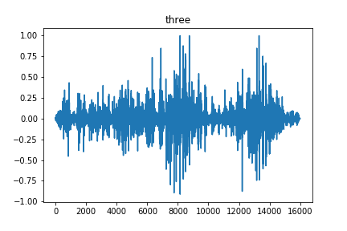
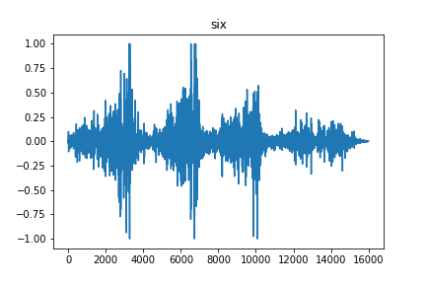
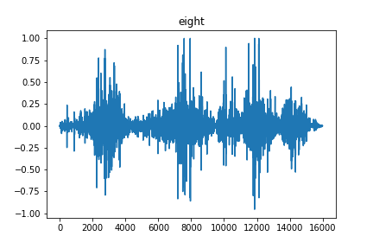

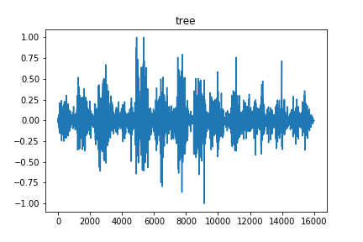
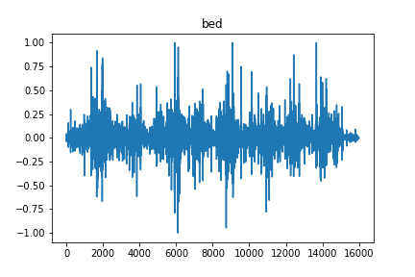
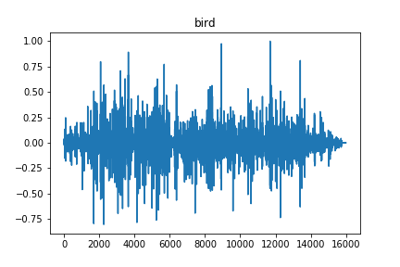
AM in 1D Model – output layer
It seems like real sound waveform
What if we listen that?
- 14 -
Notes:
Supporting facts

Slide 15

AM in 1D Model – output layer
It seems like real sound waveform
What if we listen that?
Maybe I have to find another way for listening…
- 15 -
Notes:
Supporting facts

Slide 16
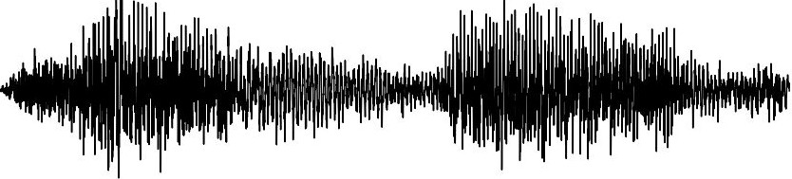


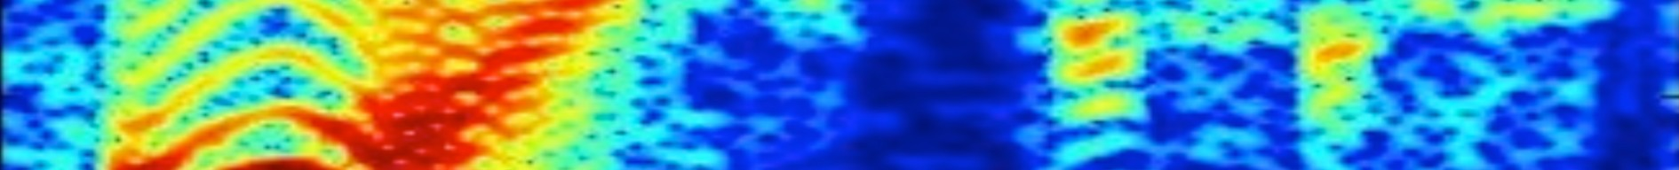

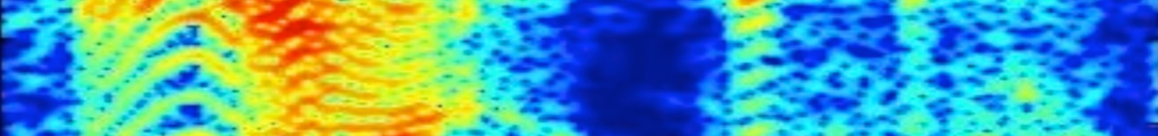
AM in 1D Model – Visualize like SampleCNN
Visualization process detail
1
Initialize input randomly (random noise)
3
STFT
4
Do this for all the filters on all layers and combine them
3
Frequency
STFT
strided conv
FFT Size == Output length
(16000)
16000 × 128
Back prop.
Channel
2
Do backpropagation such that the mean of the value of channel is maximum.
Repeat several times to converge to input.
Time

Slide 17
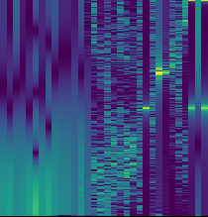
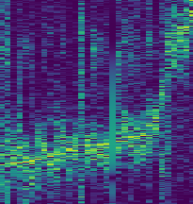
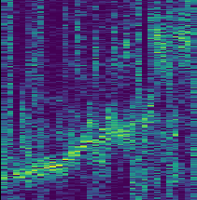
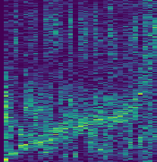
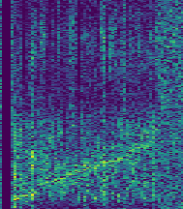
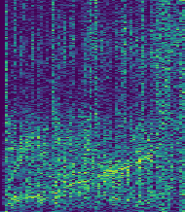
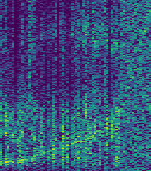
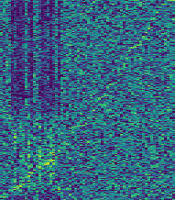
AM in 1D Model – Visualize like SampleCNN
X axis: each filter (sorted by most highest frequency of each filer)
Y axis: frequency
< 1st layer >
< 2nd layer >
< 3rd layer >
< 4th layer >
< 5th layer >
< 6th layer >
< 7th layer >
< 8th layer >
- 17 -
Notes:
Supporting facts

Slide 18
AM in 1D Model – Visualize like SampleCNN
As the result, most of result focus on around 200Hz ~ 3400Hz
In general, the frequency band between 300Hz and 3000Hz is called the voice frequency.
https://en.wikipedia.org/wiki/Voice_frequency
Therefore, It means that the model focus on the voice frequency
< 1st layer >
< 2nd layer >
< 3rd layer >
< 4th layer >
< 5th layer >
< 6th layer >
< 7th layer >
< 8th layer >
- 18 -
Notes:
Supporting facts

Slide 19
AM in 1D Model – Visualize like SampleCNN
As we can see, each filter focus on each frequency.
Therefore, It means that the channel is similar to the unsorted frequency
< 1st layer >
< 2nd layer >
< 3rd layer >
< 4th layer >
< 5th layer >
< 6th layer >
< 7th layer >
< 8th layer >
- 19 -
Notes:
Supporting facts

Slide 20
Any Question?
Thank you
Notes:
Supporting facts

